Slide 1



Dr. Hiba Shakir Ahmed
Microbiology / Clinical Immunology

Slide 2
Hepatitis viruses
Lecture 11

Slide 3
Hepatitis viruses
Viral hepatitis is a systemic disease primarily involved liver most cases of acute viral hepatitis in children and adults are caused by one of the following agent :
Hepatitis A virus (HAV), hepatitis B virus (HBV), hepatitis C virus (HCV), hepatitis E virus (HEV) .
Hepatitis viruses produce acute inflammation of the liver resulting in a clinical illness characterized by fever gastrointestinal symptoms such as nausea , vomiting and jaundice regardless of the virus type identical histopathologic lesion are observed in the liver during acute disease.

Slide 4
Hepatitis A virus :
HAV (Picornaviridae family) is a 27-32 nm spherical particle with cubic symmetry and containing a linear single stranded RNA genome with a size of 7.5 kb Non-enveloped virus. Only one serotype is known there is no antigenic cross-reactivity with HBV or with other hepatitis viruses.
Virus particles have been detected by immune electron microscopy in fecal extracts of hepatitis A patients. Virus appears early in the disease and disappear within 2 weeks following the onset of jaundice , HAV can be detected in the liver , stool , and blood of naturally infected humans by immunoassay, nucleic acid hybridization assay, or PCR.
Anti-HAV appears in the IgM fraction during the acute phase peaking about 2 weeks after elevation of liver enzyme. Anti-HAV IgM usually declines to non-detectable level within 3-6 months. Anti-HAV IgG (chronic phase) appears soon after the onset of disease and persist for decades.
Detection of HAV IgM in serum confirms the diagnosis of hepatitis A virus. ELISA is the method of choice for measuring HAV antibodies.

Slide 5
Hepatitis B virus :
HBV establishes chronic infections especially in those infected as infants it is a major factor in the eventual development of liver disease and hepatocellular carcinoma in those individuals. HBS (hepadnavirdae family) are spherical particles , 42 nm virion , HBS genome is double strand DNA circular and 32 kb. there are three serotype of HBV (HBsAg, HBcAg, and HBeAg) (glycoprotein(
DAN polymerase activity, HBV DNA and HBeAg which are representative of the viremic stage of hepatitis B occur early in the incubation period concurrently or shortly after the first appearance of HBsAg. HBsAg is usually detectable 2-6 weeks in advance of clinical and biochemical evidence of hepatitis and persists throughout the clinical course of the disease but typically disappears by the sixth month after exposure.

Slide 6
Hepatitis C virus:
Clinical and epidemiologic studies and cross-challenge experiments in Chimpanzees had suggested that there were several non-A , non-B (NANB) hepatitis agents which based on serologic tests were not related to HAV or HBV. The major agent was identified as hepatitis C virus (HCV) , HCV is a positive-sense RNA virus , 9.4kb in size and encodes a core protein , two envelope glycoprotein's , and several nonstructural protein. Most new infections with HCV are subclinical.
High levels of IgM specific anti-Hbc are frequently detected at the onset of clinical illness. Because this antibody is directed against the 27 nm internal core component of HBV , its appearance in the serum is indicative of viral replication. Antibody to HBsAg is first detectable at a variable period after the disappearance of HBsAg. It is present in low concentrations. Before HBsAg disappears, HBeAg is replaced by anti-HBe, signaling the start of resolution of the disease. Anti-HBe level often are no longer detectable after6 months. The most useful detection methods are ELISA for HBV antigens & antibodies & PCR for viral DNA.

Slide 7
The majority (70-90%) of HCV patients develop chronic hepatitis and many are at risk of progressing to chronic active hepatitis and cirrhosis.
Most primary infections are asymptomatic or clinically mild (20-30% have jaundice , 10-20% have only non-specific symptoms such as anorexia , malaise , and abdominal pain). Serological assay are available for diagnosis of HCV infection.
Enzyme Linked immunosorbent assay (ELISA) detect antibodies to HCV but do not distinguish between acute and chronic phases or resolved infection.
Anti-HCV antibodies can be detected in 50-70% of patients at onset of symptoms, whereas in others antibody appearance is delayed 3-6 weeks. Antibodies are directed against core, envelope. Nucleic acid assay (RT-PCR) detect the presence of circulating HCV RNA and are useful for monitoring patients on antiviral therapy.

Slide 8
Laboratory Diagnosis :
Liver permits a tissue diagnosis of hepatitis , test for abnormal liver function test such as Alanine aminotransferase (ATL) and bilirubin , supplement the clinical , pathologic , and epidermiologic finding.

Slide 9
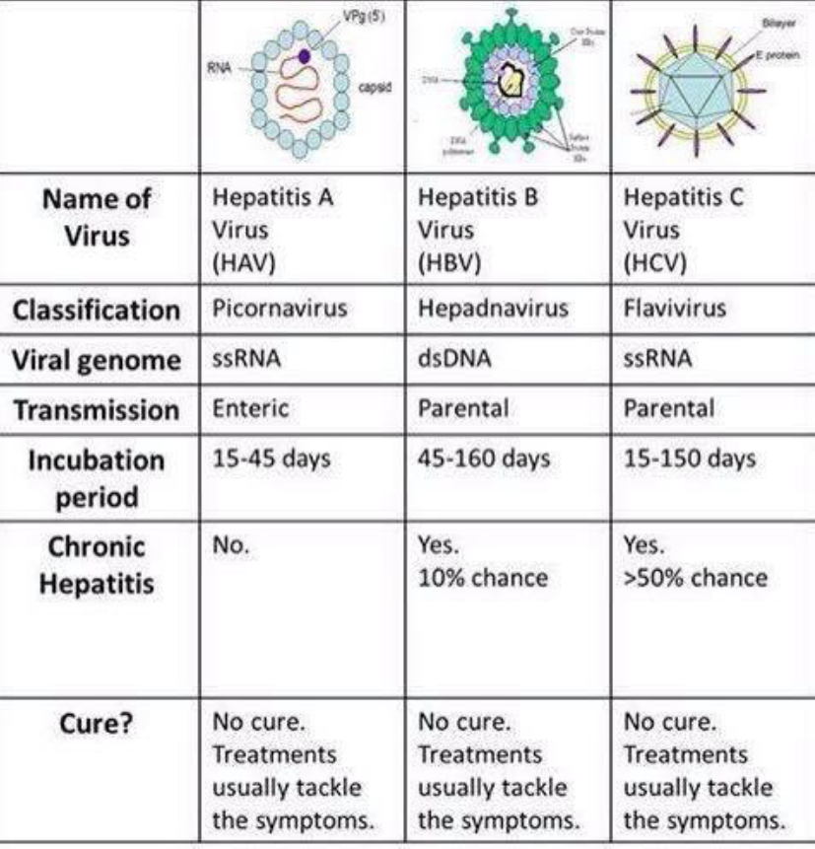

Slide 10


